Slide 1
Basic Architectures
The building blocks for complex systems

Slide 2
Contents
Monolith – a cohesive codebase.
Shards – multiple instances of a (sub)system.
Layers – subdivision by the level of abstractness.
Services – components, dedicated to subdomains.
Pipeline – a chain of data processing steps.
… and common variants of each of the architectures.

Slide 3
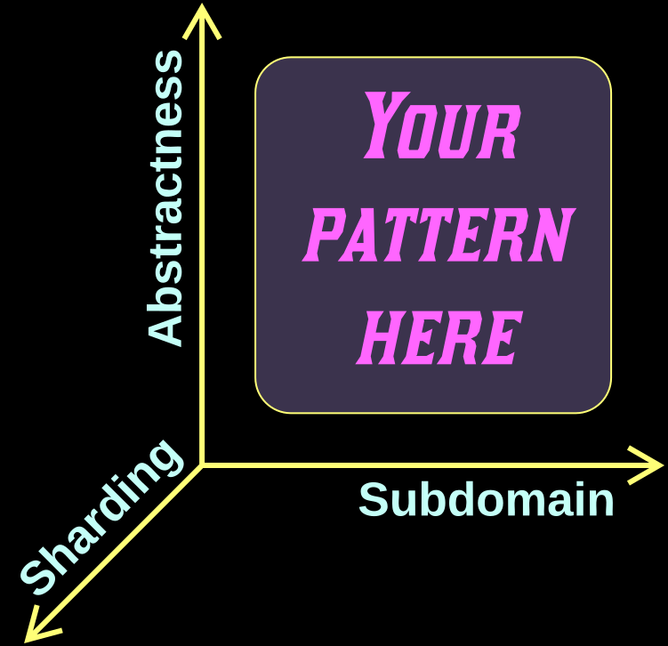
A bit of background
We are comparing patterns by drawing them with common axes:
– Abstractness
– Subdomain
– Sharding
A basic architecture is partitioned along one of these axes

Slide 4
Monolith
A cohesive (sub-)system

Slide 5
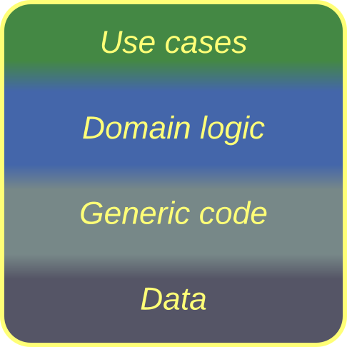
Monolith – overview
A Monolith (“single stone”) is a cohesive (sub-)system.
In a strict sense, it cannot be subdivided.
In a loose sense, we don’t want to look inside it.
The word “Monolith” has been redefined several times (the latest version being “a single unit of deployment”) but we’ll stick to its original meaning.
Monolith,
Big Ball of Mud
Monolith is good for quickly coding a tiny one-off project.
Anything larger or longer-living will be difficult to support.

Slide 6
Monolith – trade-offs
Is easy to write and debug
Allows for low latency
Permits thorough performance optimizations
Maintains a self-consistent state
Is hard to read, change, and support
Does not scale
Is not fault tolerant
Is developed by a single team
Is limited to one technology and style
Aligns with a single set of forces

Slide 7
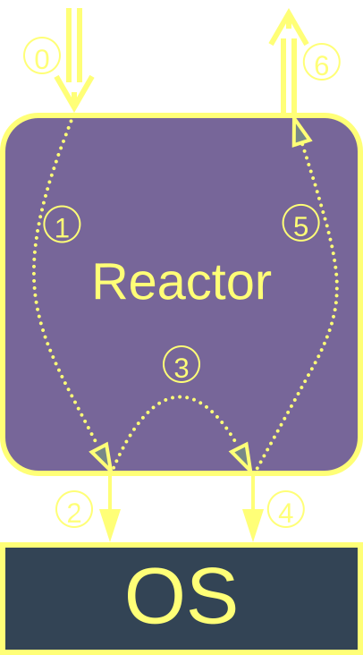
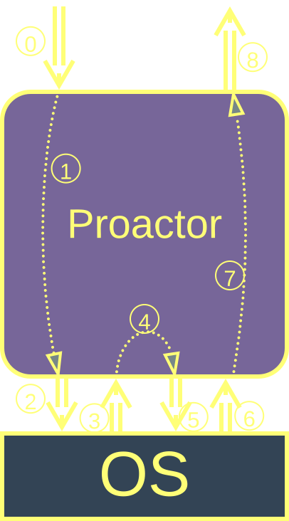
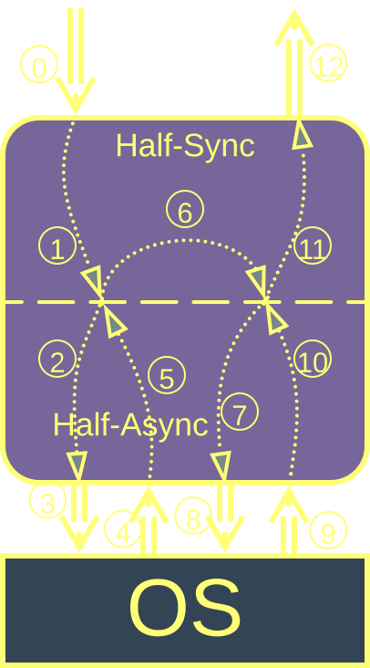
Monolith – event handling
A blocking thread per request | A single non-blocking thread processes all events | A coroutine or fiber per request

Slide 8
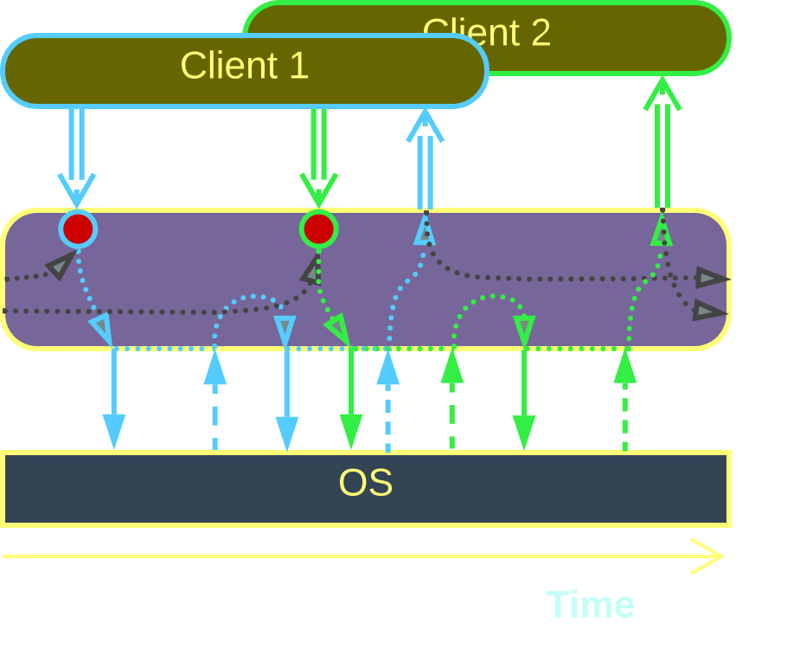
Monolith – event handling
A Reactor runs each task in a blocking thread.
A backend Reactor uses OS threads to execute many requests in parallel. Any shared resources must be protected with locks.
An embedded system may wrap a physical device with a single-threaded Reactor to avoid race conditions in the hardware.
Reactor
Reactor’s code is simple & stupid.
However, each thread takes a lot of system resources.

Slide 9
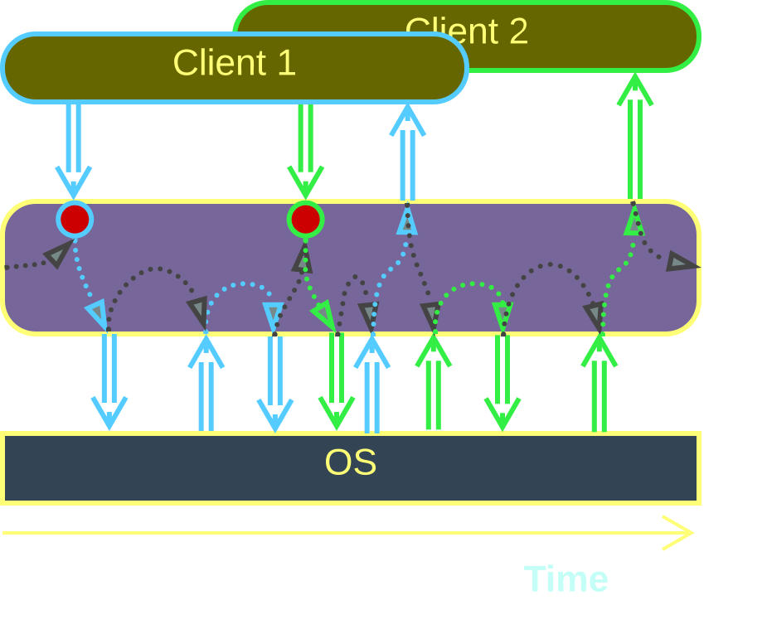
Monolith – event handling
A Proactor handles everything with a single non-blocking thread.
There is no need for locks and no associated delays, therefore the system reacts to events in real time and its state is always up-to-date.
Proactor
Proactor fits real-time control systems.
Sadly, its logic is dispersed over many event handlers.

Slide 10
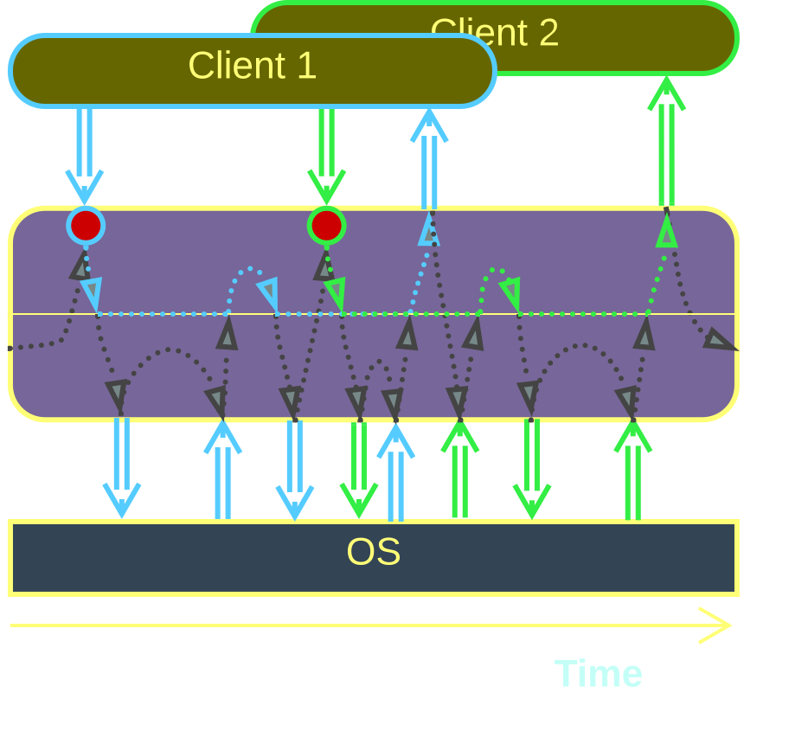
Monolith – event handling
A Half-Sync / Half-Async system allocates a blocking coroutine for each task. All the coroutines run in the same thread or thread pool.
The upper half of the system is like a Reactor.
The lower half is a Proactor.
Half-Sync /
Half-Async
The code of each coroutine is simple.
But the underlying framework is complex.

Slide 11
Shards
Multiple instances of a (sub-)system

Slide 12
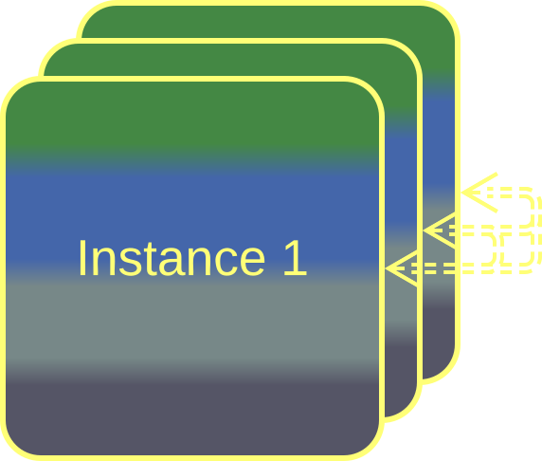
Shards – overview
Shards are multiple instances of a component.
They may or may not differ in their data.
In most systems shards don’t intercommunicate directly.
Shards, Instances,
Replicas
Shards provide scalability and fault tolerance…
…as long as there is no shared data.

Slide 13
Shards – trade-offs
The (sub-)system becomes scalable
Sharding may be used to improve latency and / or fault tolerance
It is hard to achieve state consistency
There is an operational effort to deploy or update the shards

Slide 14
Shards – isolation
Isolation | Benefits | Drawbacks
A thread per shard | Limited scalability | Shared data needs locks
A process per shard | Software fault tolerance | Sharing data is non-trivial
A server per shard | Full scalability and fault tolerance | Sharing data is impossible State synchronization is complicated

Slide 15
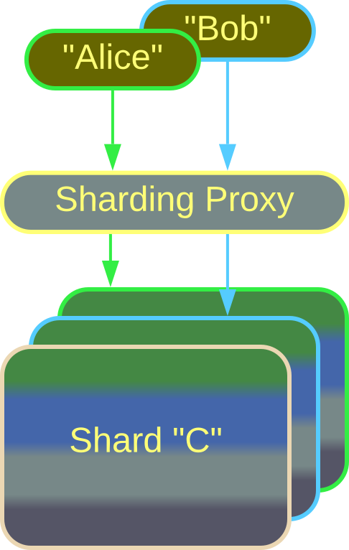
Shards – state
Each partition owns a slice of the system’s data.
A client’s access is usually limited to one partition.
A Sharding Proxy connects clients to their partitions.
Shards, Partitions
Partitioning scales the data storage.
No data can be shared among the system’s clients.

Slide 16
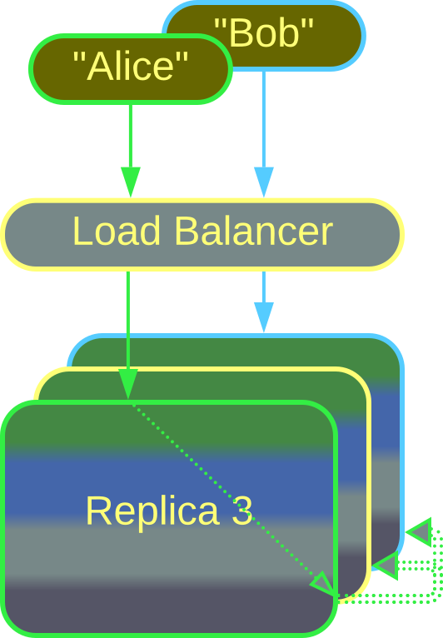
Shards – state
Each replica has a copy of the whole system’s data.
A Load Balancer connects new clients to idle replicas.
The replicas need to keep their data in sync:
There may be a leader which processes all write requests and broadcasts the changes to the followers.
Or the data to be changed must be locked in all the replicas to avoid write conflicts.
Replicas
Replication improves fault tolerance and read performance.
But it is costly and complicates write access to the data.

Slide 17
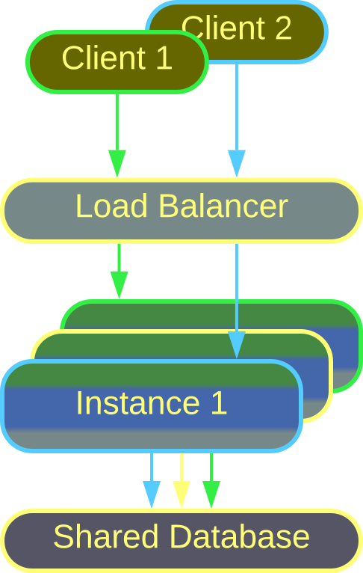
Shards – state
System instances may be stateless.
That requires both a Load Balancer to choose an instance from the pool and a Shared Repository to persist the data.
The Shared Repository (database or file storage) may become the single point of failure and performance bottleneck.
The number of instances in the pool may be fixed or elastic.
Instances, Lambdas
Stateless instances are perfectly scalable and fault tolerant.
But now the Shared Repository becomes the bottleneck.

Slide 18
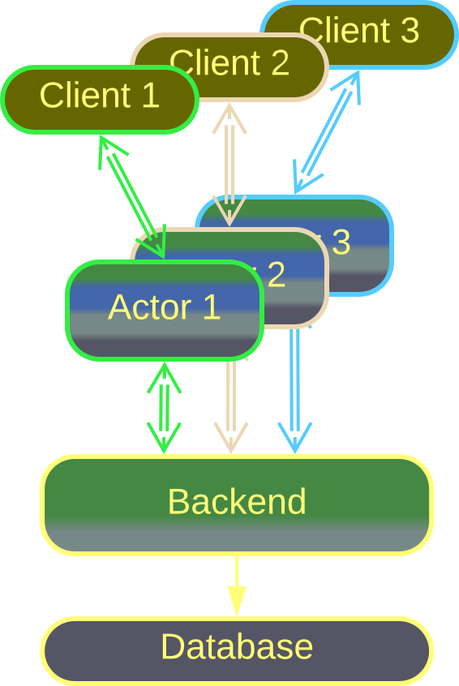
Shards – state
A stateful instance of a component can be created for each client.
Such an Actor keeps the client’s data readily available in its memory and acts on behalf of its client.
The changes to Actors’ states are persisted to a database.
Actors
Actors grant low request latency and fault isolation between clients.
Complex logic that involves multiple clients is impossible.

Slide 19
Layers
Components that differ in abstractness

Slide 20
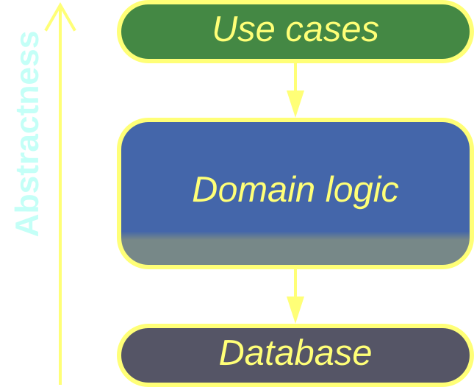
Layers – overview
Layers are system-wide components that differ in their abstractness.
An upper layer may depend on a lower layer or its interface. A lower layer knows nothing about the layers above it.
Tiers are distributed Layers.
Layers, Tiers
Layering provides flexibility to small- and medium-sized projects…
…at the cost of lost optimization opportunities.

Slide 21
Layers – trade-offs
Each layer may be developed by a dedicated team
The layers may differ in technologies, scalability, security, and even hardware and physical location
The business logic is separated from reusable generic code
The number of layers and associated teams is usually limited to 3 or 4.
The interfaces between layers tend to negatively impact performance

Slide 22
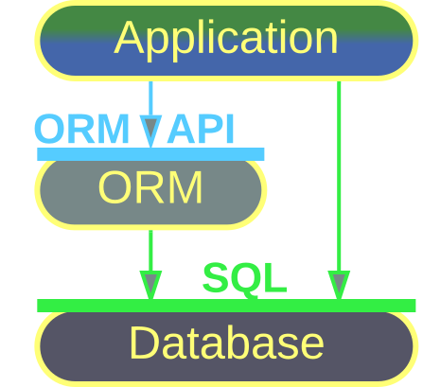
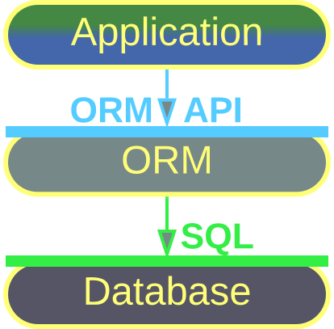
Layers – openness
An open layer is transparent – the layer above it may directly access the layer below it.
A closed layer is opaque – it hides everything below it from its clients.
Open layer
Closed layer
Notes:
https://metapatterns.io/basic-metapatterns/layers/

Slide 23
Layers – isolation
Isolation | Benefits | Drawbacks
Synchronous layers | Encapsulation Multiple teams | Lost optimization opportunities
Asynchronous layers | Low latency | Complicated debugging
A process per layer | Independent technologies, deployment and scalability Software fault isolation | Inconsistent state after errors
Distributed tiers | Independent hardware and location | Slow communication between layers

Slide 24
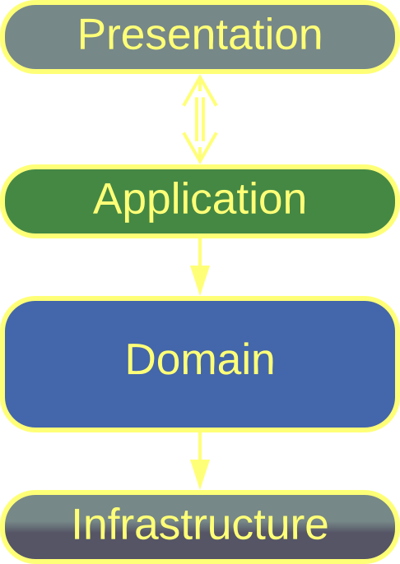
Layers – examples
Domain-Driven Design defines the following layers:
Presentation (user interface)
Application (integration or use cases)
Domain (business rules)
Infrastructure (utilities and data access)
DDD Layers

Slide 25
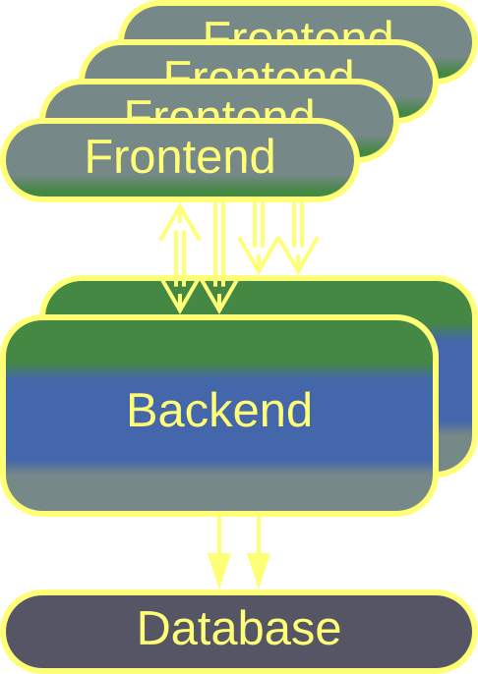
Layers – examples
Tiers are distributed Layers.
3-Tier Architecture contains:
Frontend (user interface)
Backend (business logic)
Database (persistent data)
The tiers differ in their scalability, location, and security.
3-Tier system

Slide 26
Services
Subdomain-aligned components

Slide 27
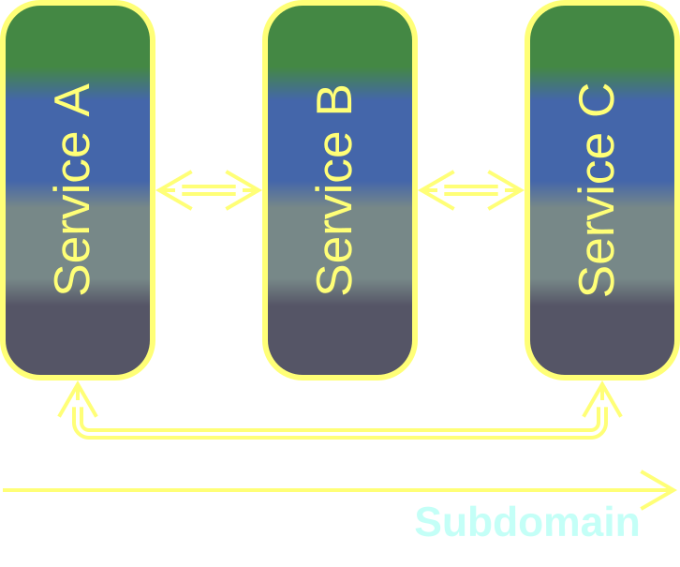
Services – overview
Services employ a component per subdomain.
When the subdomains are loosely coupled, the corresponding services can be developed by fairly independent teams with minimal communication overhead.
Services, Modules
Services are good for large projects with several teams.
They require the subdomains to be stable and loosely coupled.

Slide 28
Services – trade-offs
Services fit large projects with several teams
The subdomains may vary in technologies and scaling
A degree of fault tolerance is achieved with loosely coupled services
Use cases that involve multiple subdomains become slow and complicated
It is hard to synchronize the states of the services
Subdomains boundaries should never change
There is operational complexity

Slide 29
Services – isolation
Isolation | Benefits | Drawbacks
Synchronous modules | Multi-team development | Subdomain boundaries are frozen
Asynchronous modules | Event replay | Hard to share data or debug across services
Multiple processes | Independent technologies and scalability | Inconsistent state after errors
Distributed services | Granular scalability Good fault isolation | High communication overhead

Slide 30
Services – size
Size | Architecture | Traits
Whole subdomain | Service-Based Architecture | Easy to design and implement
Part of a subdomain | Microservices | Fine-grained scalability
Class-like | Actors | Real-time latency and low resource consumption
Single function | Nanoservices | Reusable components?

Slide 31
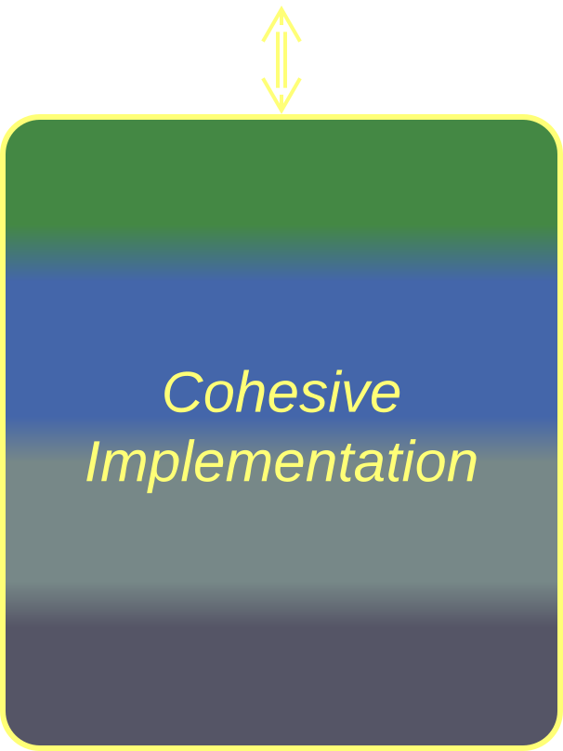
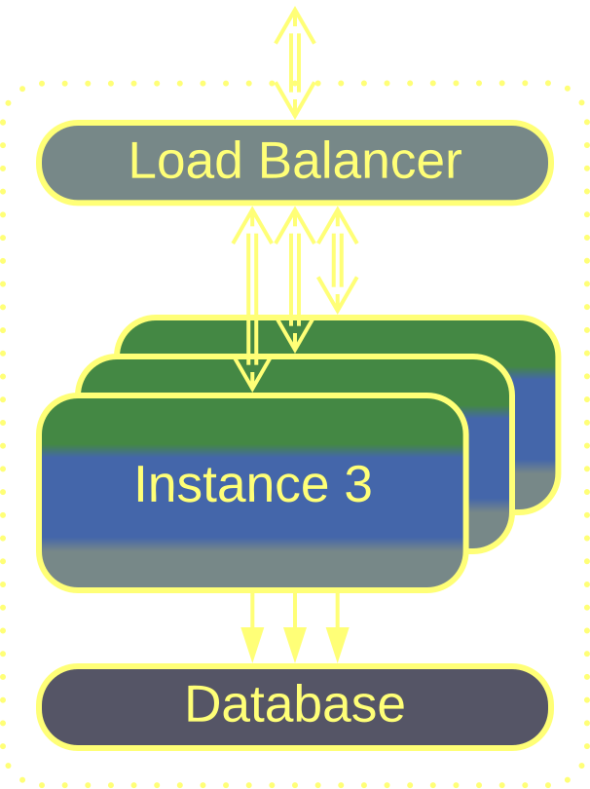
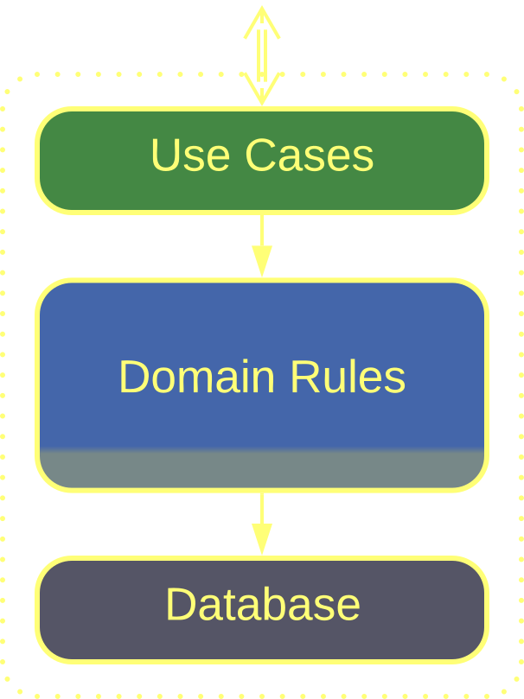
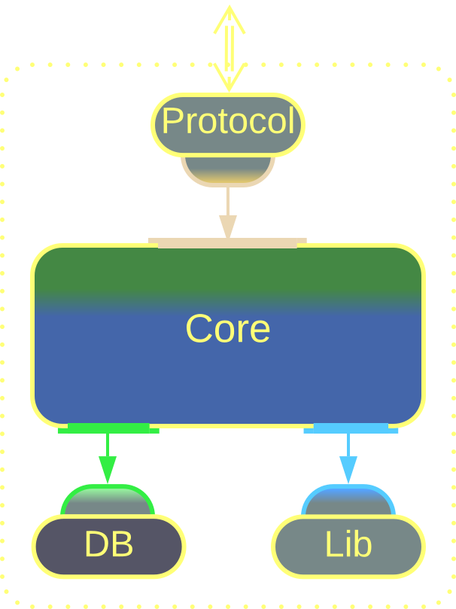
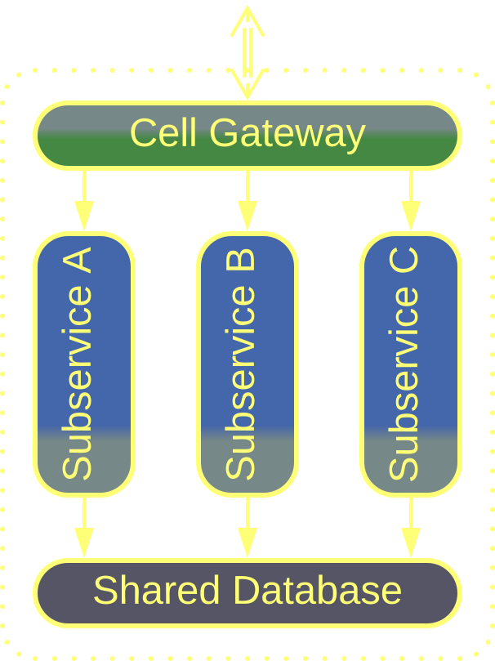
Services – internals
Monolithic service | Scaled service | Layered service | Cell | Hexagonal service

Slide 32
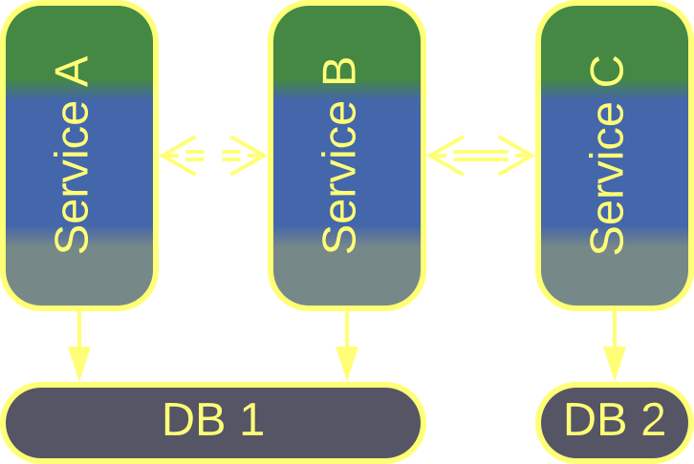
Services – examples
Service-Based Architecture (SBA) is made of coarse-grained subdomain services.
Some or all of them may share a database. They may not be independently deployable.
Being pragmatic, SBA violates best practices in favor of simplicity.
Service-Based Architecture

Slide 33
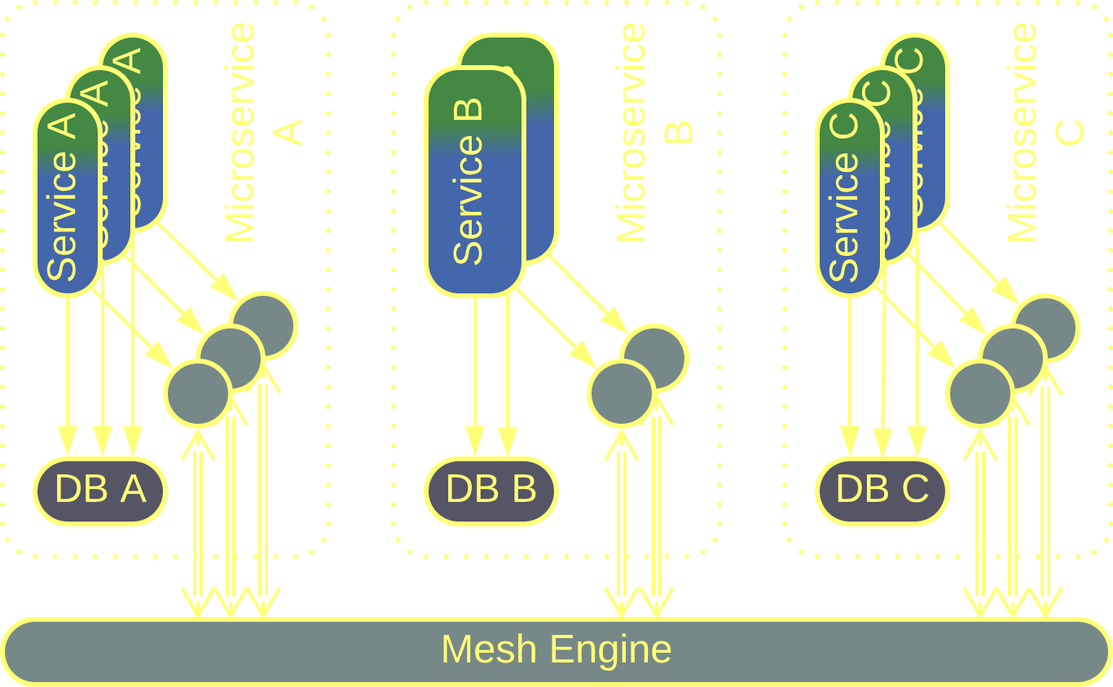
Services – examples
Microservices follow best practices:
Private code and databases.
Independent scaling and deployment with a Service Mesh.
Mostly asynchronous communication.
Fine-grained responsibilities.
Shared libraries are placed into Sidecars.
Microservices

Slide 34
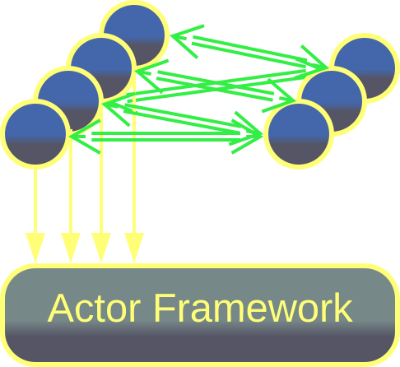
Services – examples
Actors are asynchronous objects.
Each actor represents a physical or logical entity, such as a bank client or chat participant.
An Actor Framework runs millions of interconnected actors.
Actors

Slide 35
Pipeline
A component per step of data processing

Slide 36
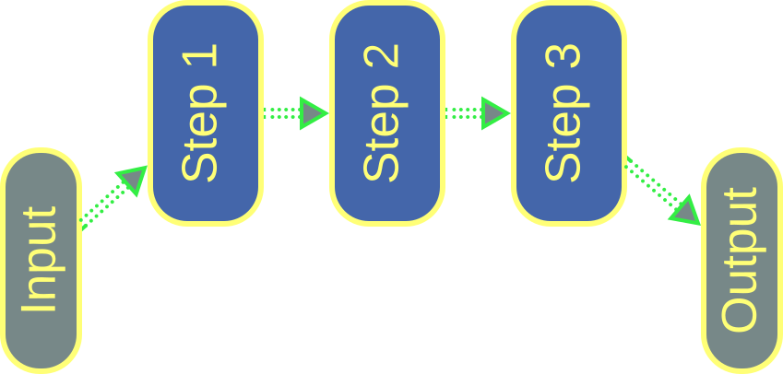
Pipeline – overview
A Pipeline passes a stream of data through a chain of components that transform it or react to it.
As each component has well-defined input(s) and output(s), it is easy to test in isolation or replace.
Pipeline is a kind of Services with unidirectional data flow.
Pipeline
Pipeline fits simple data-intensive projects.
Any integration logic multiplies system components.

Slide 37
Pipeline – trade-offs
Pipeline supports multiple development teams and technologies
The components are easy to add, remove, replace, and can be tested in isolation
The system is highly scalable
Pipeline supports only a few simple use cases with rudimentary error handling
The latency is high
Not every domain can be represented as a Pipeline

Slide 38
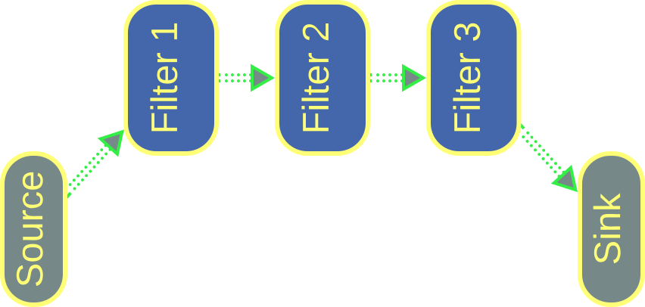
Pipeline – examples
Pipes and Filters is the simplest kind of Pipeline. It is often run locally.
A filter receives an input, transforms it, and produces an output.
A pipe connects the output of a filter to the input of another filter.
Pipes and Filters

Slide 39
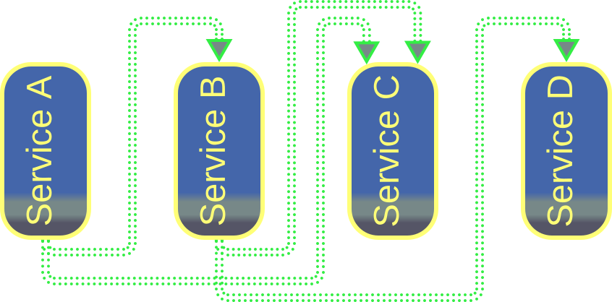
Pipeline – examples
Event-Driven Architecture (EDA) is a tree of subdomain services which subscribe to each other’s events.
It is easy to extend with new services.
Choreographed Event-Driven Architecture

Slide 40
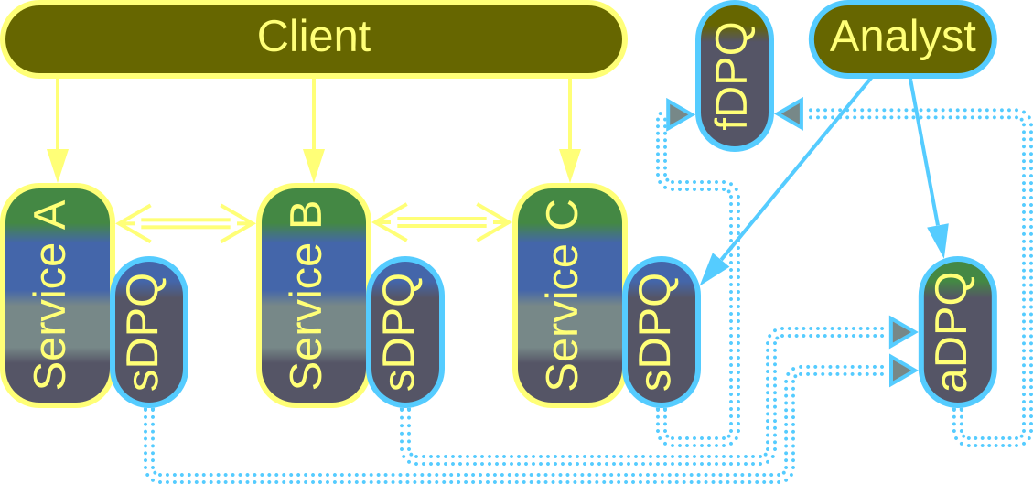
Pipeline – examples
Data Mesh is a graph of streams of analytical information. Its nodes are called Data Product Quanta (DPQ).
It extends any kind of distributed system, extracting its data analytics aspect into an overlapping set of services and databases.
Data Mesh

Slide 41
Conclusion

Slide 42
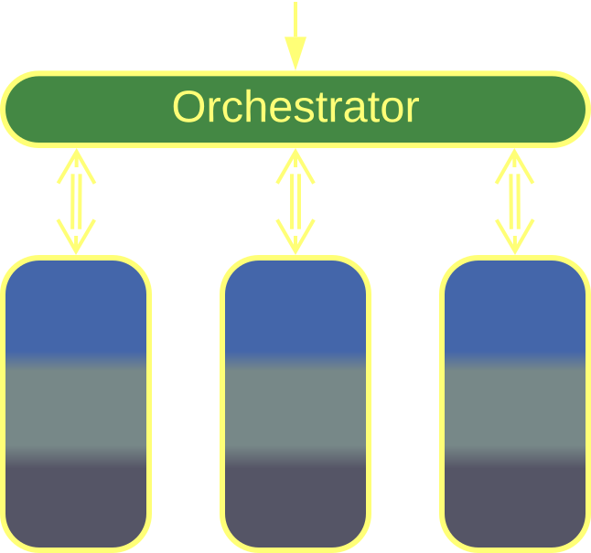
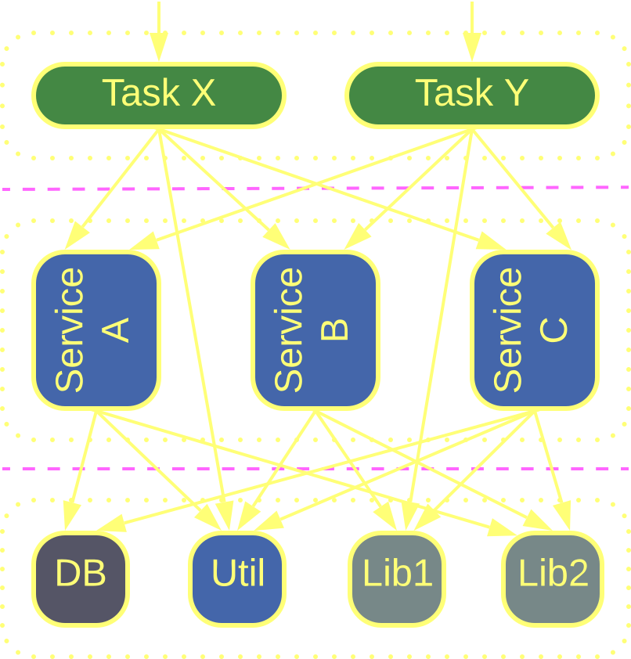
Building complex architectures
Shards, Layers and Services can be combined, often recursively, for example:
A single integration layer over services makes Orchestrated Services.
Layers, divided into Services, make Service-Oriented Architecture.
Orchestrated Services
Service-Oriented Architecture
Notes:
https://metapatterns.io/basic-metapatterns/layers/

Slide 43
Links
All of this and much more can be found in my book Architectural Metapatterns:
– read online at metapatterns.io
– download from leanpub.com/metapatterns
The diagrams and the ODT source file are available under the CC BY license.
The book is free.
No strings attached.

